Slide 1
Lecture:
Color
Juan Carlos Niebles and Ranjay Krishna
Stanford AI Lab

Slide 2
Overview of Color
Physics of color
Human encoding of color
Color spaces
White balancing

Slide 3
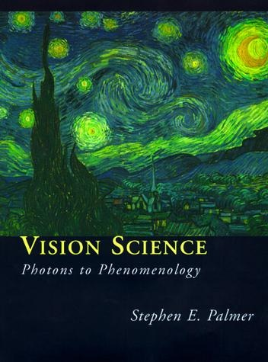
What is color?
The result of interaction between physical light in the environment and our visual system.
A psychological property of our visual experiences when we look at objects and lights, not a physical property of those objects or lights.
Slide credit: Lana Lazebnik

Slide 4
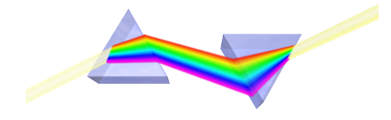
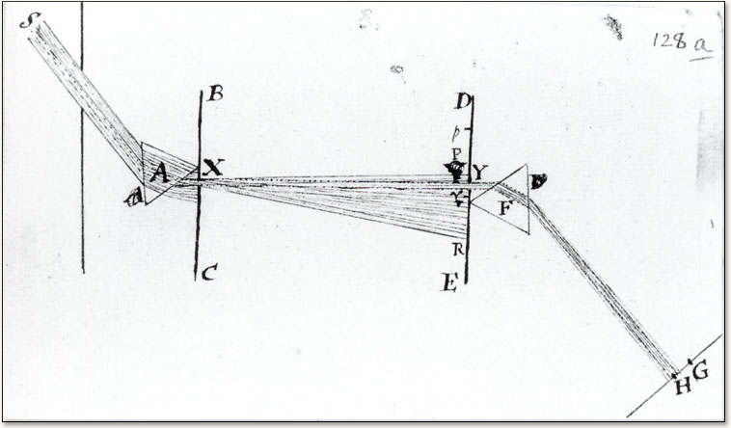
Color and light
White light: composed of almost equal energy in all wavelengths of the visible spectrum
Newton 1665
Image from http://micro.magnet.fsu.edu/
Notes:
As the full spectrum of visible light travels through a prism, the wavelengths separate into the colors of the rainbow because each color is a different wavelength. Violet has the shortest wavelength, at around 380 nanometers, and red has the longest wavelength, at around 700 nanometers.
Sir Isaac Newton, held the theory that light was made up of tiny particles. In 1678, Dutch physicist, Christiaan Huygens, believed that light was made up of waves vibrating up and down.

Slide 5
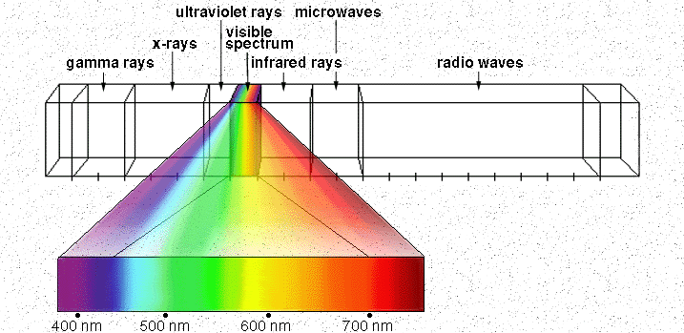
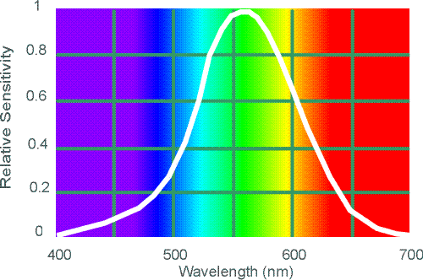
Electromagnetic Spectrum
Human Luminance Sensitivity Function
http://www.yorku.ca/eye/photopik.htm
Notes:
5
At least 3 spectral bands required (e.g. R,G,B)

Slide 6
Sun temperature makes it emit yellow light more than any other color.
Notes:
The Sun is the dominant source for visible-light waves our eyes receive. The outer-most layer of the Sun's atmosphere, the corona, can be seen in visible light. But it is so faint it cannot not be seen except during a total solar eclipse because the bright photosphere overwhelms it. The tapered patterns—coronal streamers—around the Sun are formed by the outward flow of plasma that is shaped by magnetic field lines extending millions of miles into space.
As objects grow hotter, they radiate energy dominated by shorter wavelengths, changing color before our eyes. A flame on a blow torch shifts from reddish to bluish in color as it is adjusted to burn hotter. In the same way, the color of stars tells scientists about their temperature.

Slide 7
Visible Light
Plank’s law for Blackbody radiation
Surface of the sun: ~5800K
Why do we see light of these wavelengths?
…because that’s where the
Sun radiates EM energy
© Stephen E. Palmer, 2002

Slide 8
The Physics of Light
Any source of light can be completely described
physically by its spectrum: the amount of energy emitted
(per time unit) at each wavelength 400 - 700 nm.
Relative spectral power
© Stephen E. Palmer, 2002

Slide 9
The Physics of Light
Some examples of the spectra of light sources
Rel. power
Rel. power
Rel. power
Rel. power
© Stephen E. Palmer, 2002

Slide 10
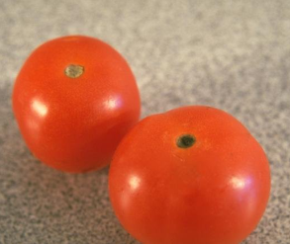
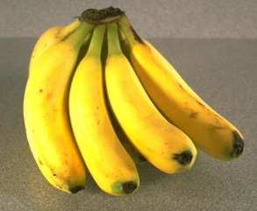
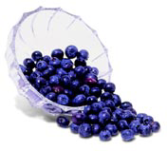
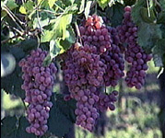
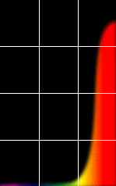
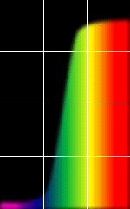
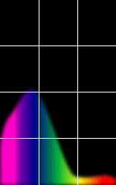
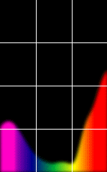
The Physics of Light
Some examples of the reflectance spectra of surfaces
Red
Yellow
Blue
Purple
% Light Reflected
400 700
400 700
400 700
400 700
Wavelength (nm)
© Stephen E. Palmer, 2002

Slide 11
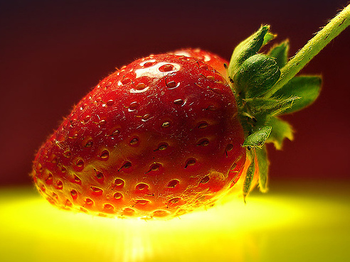
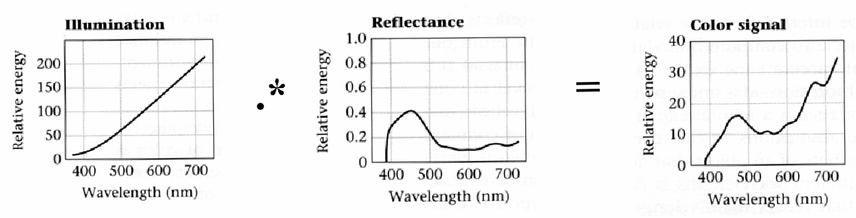
Interaction of light and surfaces
Reflected color is the result of interaction of light source spectrum with surface reflectance
Spectral radiometry
All definitions and units are now “per unit wavelength”
All terms are now “spectral”
From Foundation of Vision by Brian Wandell, Sinauer Associates, 1995

Slide 12
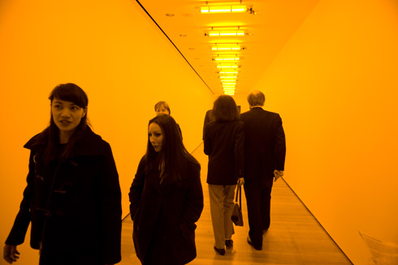
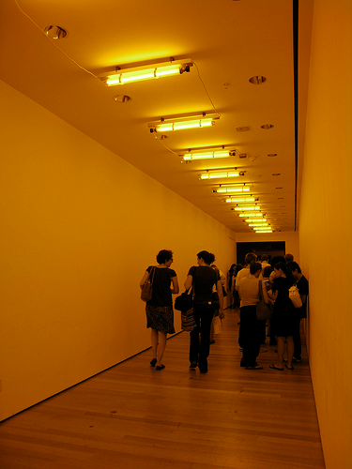
Interaction of light and surfaces
What is the observed color of any surface under monochromatic light?
Olafur Eliasson, Room for one color
Slide by S. Lazebnik

Slide 14
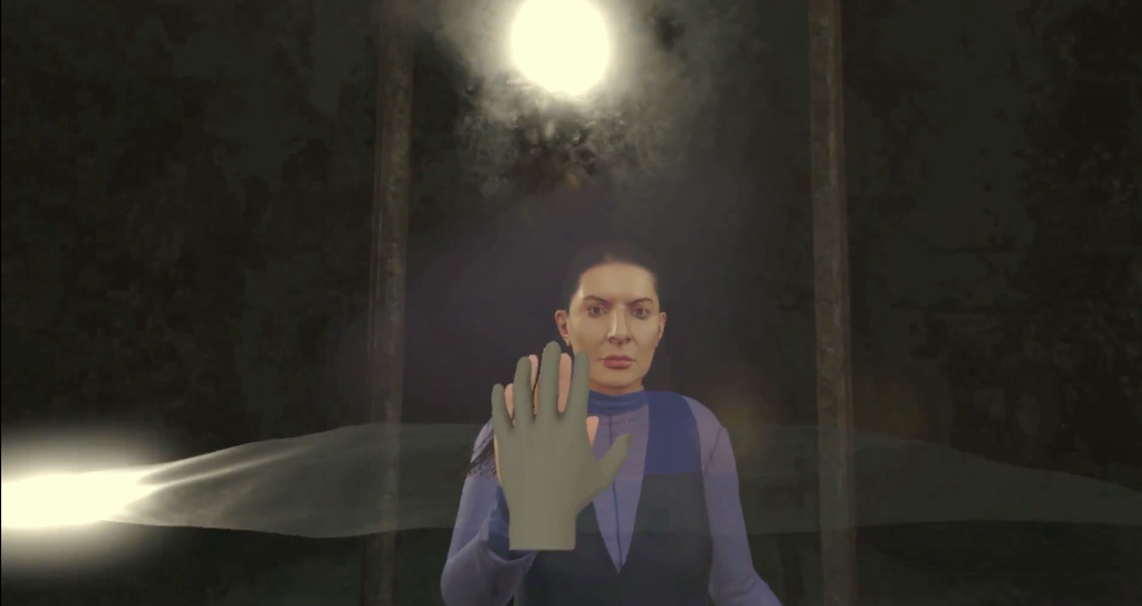
Notes:
He inspired how we design for virtual reality and create environments enhance our perception of the world. That make us experience something we can’t in our real world.

Slide 15
James Turrell, Breathing Light
Notes:
James Turrell, a Californian artist, used light and color to completely immerse people in a world where there was no depth perception.

Slide 16
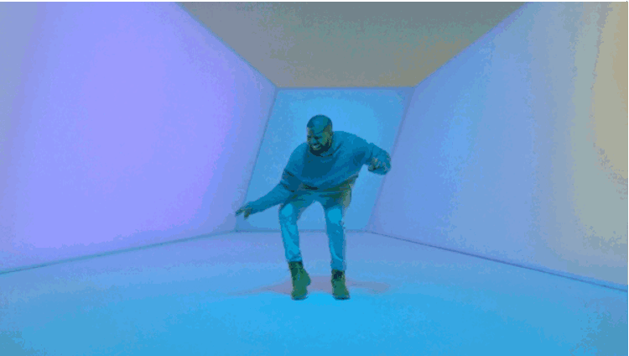
Inspired Drake in “Hotline Bling”

Slide 17
Overview of Color
Physics of color
Human encoding of color
Color spaces
White balancing

Slide 18
Two types of light-sensitive receptors
Cones
cone-shaped
less sensitive
operate in high light
color vision
Rods
rod-shaped
highly sensitive
operate at night
gray-scale vision
© Stephen E. Palmer, 2002

Slide 19
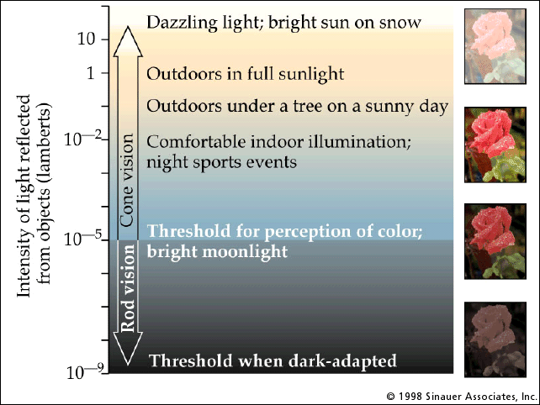
Rod / Cone sensitivity
The famous sock-matching problem…

Slide 20
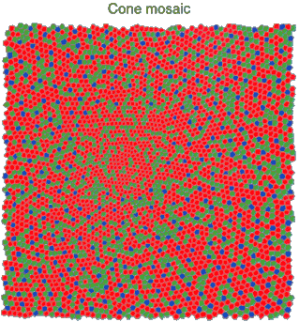
Physiology of Color Vision
Three kinds of cones:
© Stephen E. Palmer, 2002

Slide 21
Color perception
M
L
Power
S
Wavelength
Rods and cones act as filters on the spectrum
To get the output of a filter, multiply its response curve by the spectrum, integrate over all wavelengths
Each cone yields one number
Q: How can we represent an entire spectrum with 3 numbers?
A: We can’t! Most of the information is lost.
As a result, two different spectra may appear indistinguishable
such spectra are known as metamers
Slide by Steve Seitz

Slide 22
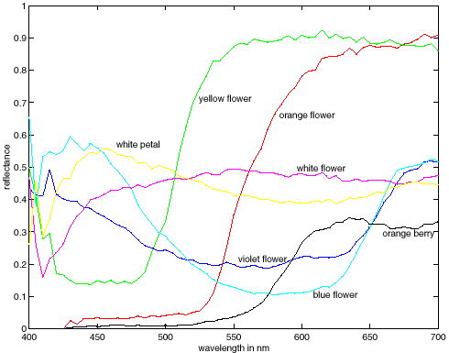
Spectra of some real-world surfaces
metamers

Slide 23
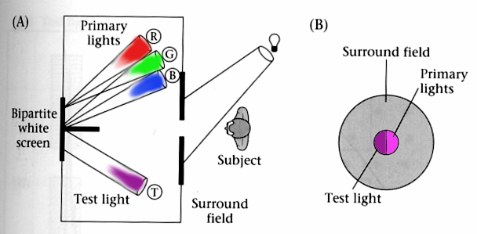
Standardizing color experience
We would like to understand which spectra produce the same color sensation in people under similar viewing conditions
Color matching experiments
Foundations of Vision, by Brian Wandell, Sinauer Assoc., 1995

Slide 24
Color matching experiment 1
Source: W. Freeman

Slide 25
Color matching experiment 1
p₁ p₂ p₃
Source: W. Freeman

Slide 26
Color matching experiment 1
p₁ p₂ p₃
Source: W. Freeman

Slide 27
Color matching experiment 1
The primary color amounts needed for a match
p₁ p₂ p₃
Source: W. Freeman

Slide 28
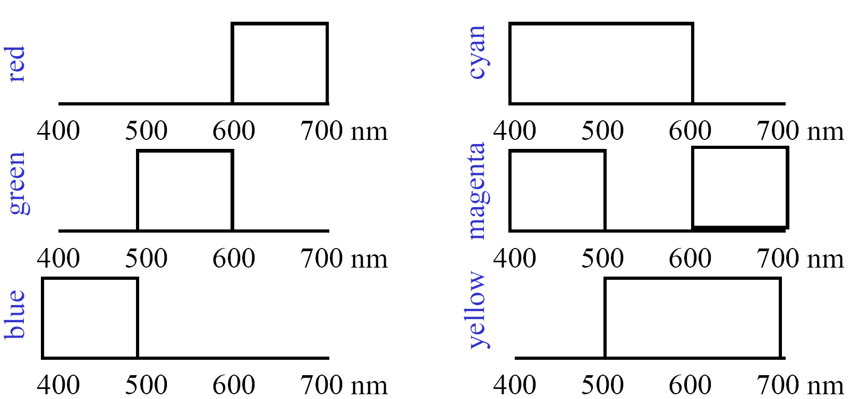
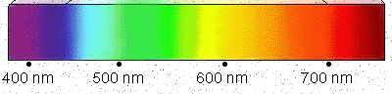
Color mixing
Source: W. Freeman

Slide 29
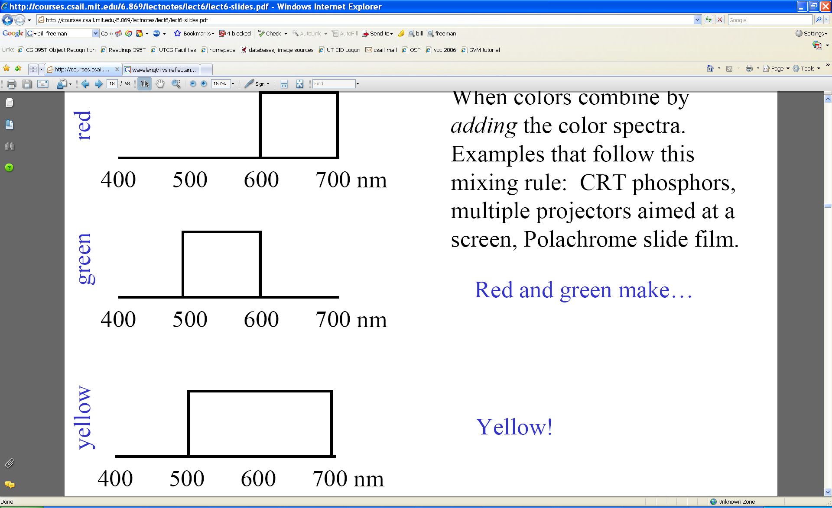
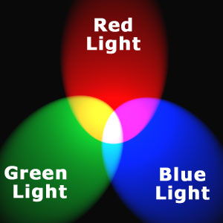
Additive color mixing
Colors combine by adding color spectra
Light adds to existing black.
Source: W. Freeman

Slide 30
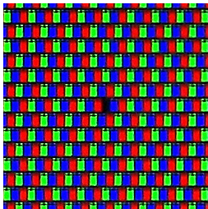
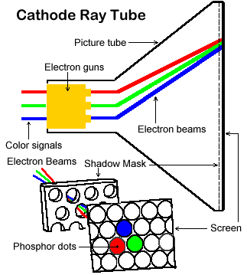
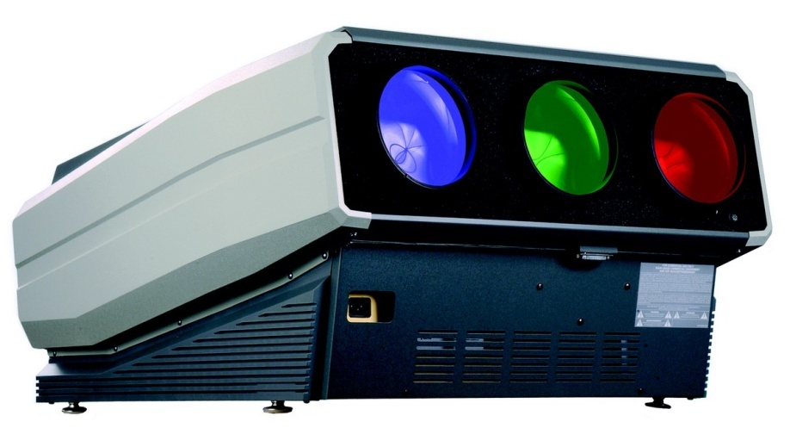
Examples of additive color systems
CRT phosphors
multiple projectors
http://www.jegsworks.com
http://www.crtprojectors.co.uk/

Slide 31
Color matching experiment 2
Source: W. Freeman

Slide 32
Color matching experiment 2
p₁ p₂ p₃
Source: W. Freeman

Slide 33
Color matching experiment 2
p₁ p₂ p₃
Source: W. Freeman

Slide 34
Color matching experiment 2
The primary color amounts needed for a match:
We say a “negative” amount of p₂ was needed to make the match, because we added it to the test color’s side.
p₁ p₂ p₃
p₁ p₂ p₃
p₁ p₂ p₃
Source: W. Freeman

Slide 35
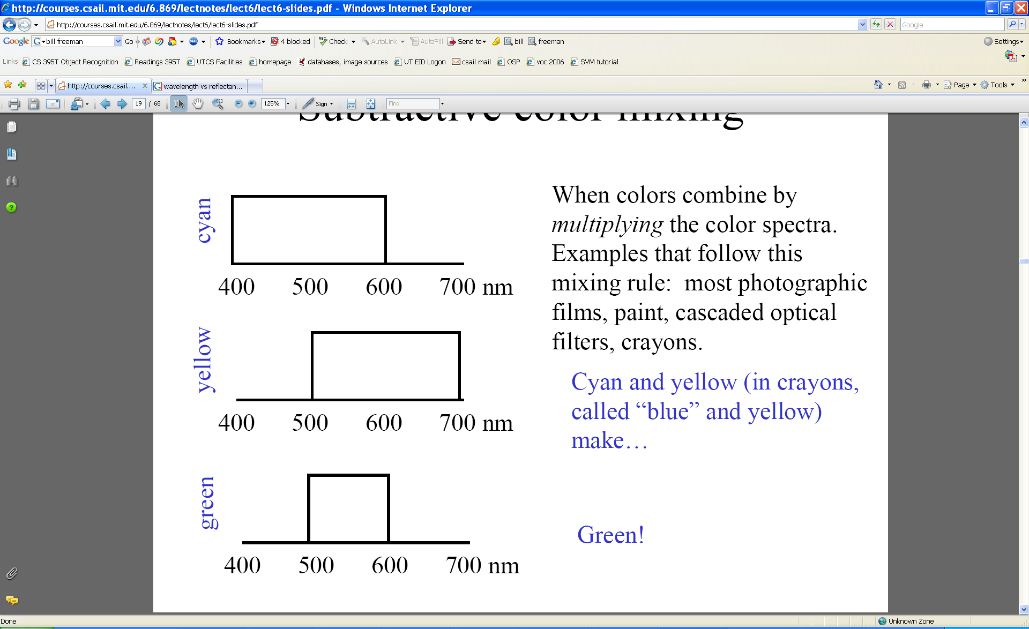
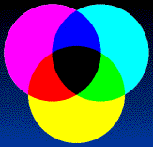
Subtractive color mixing
Colors combine by multiplying color spectra.
Pigments remove color from incident light (white).
Source: W. Freeman

Slide 36
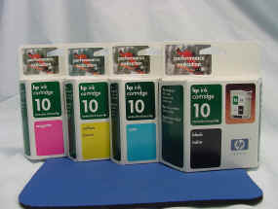
Examples of subtractive color systems
Printing on paper
Crayons
Photographic film

Slide 37
Trichromacy
In color matching experiments, most people can match any given light with three primaries
Primaries must be independent
For the same light and same primaries, most people select the same weights
Exception: color blindness
Trichromatic color theory
Three numbers seem to be sufficient for encoding color
Dates back to 18th century (Thomas Young)
Notes:
Linear matching: suppose A = u1 P1 + u2 P2 + u3 P3 and B = v1 P1 + v2 P2 + v3 P3. Then A+B = (u1+v1)P1 + (u2+v2)P2 + (u3+v3)P3.
Also, suppose A = u1 P1 + u2 P2 + u3 P3. Then kA = (k u1) P1 + (k u2) P2 + (k u3) P3.

Slide 38
Overview of Color
Physics of color
Human encoding of color
Color spaces
White balancing

Slide 39
Linear color spaces
Defined by a choice of three primaries
The coordinates of a color are given by the weights of the primaries used to match it
mixing two lights produces colors that lie along a straight line in color space
mixing three lights produces colors that lie within the triangle they define in color space

Slide 40
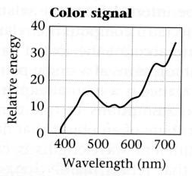
How to compute the weights of the primaries to match any spectral signal
p₁ p₂ p₃
Matching functions: the amount of each primary needed to match a monochromatic light source at each wavelength
Source: W. Freeman

Slide 41

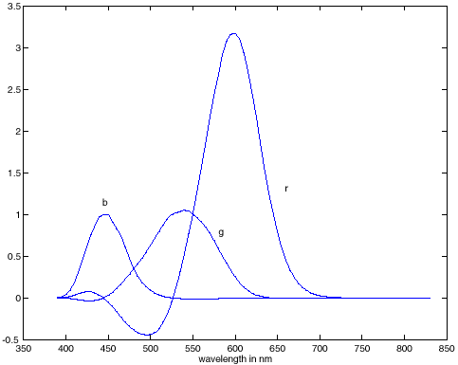
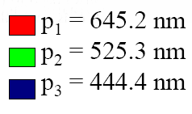
RGB space
Primaries are monochromatic lights (for monitors, they correspond to the three types of phosphors)
Subtractive matching required for some wavelengths
RGB primaries
RGB matching functions

Slide 42
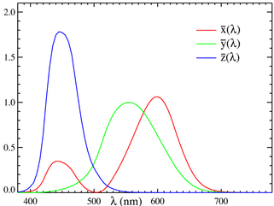
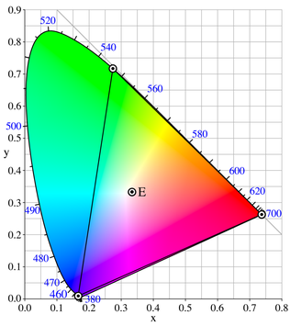
Linear color spaces: CIE XYZ
Primaries are imaginary, but matching functions are everywhere positive
The Y parameter corresponds to brightness or luminance of a color
2D visualization: draw (x,y), where x = X/(X+Y+Z), y = Y/(X+Y+Z)
Matching functions
http://en.wikipedia.org/wiki/CIE_1931_color_space

Slide 43
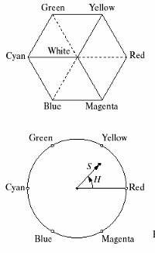
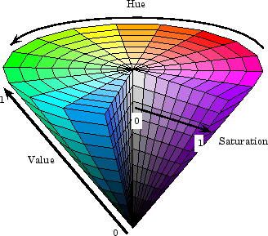
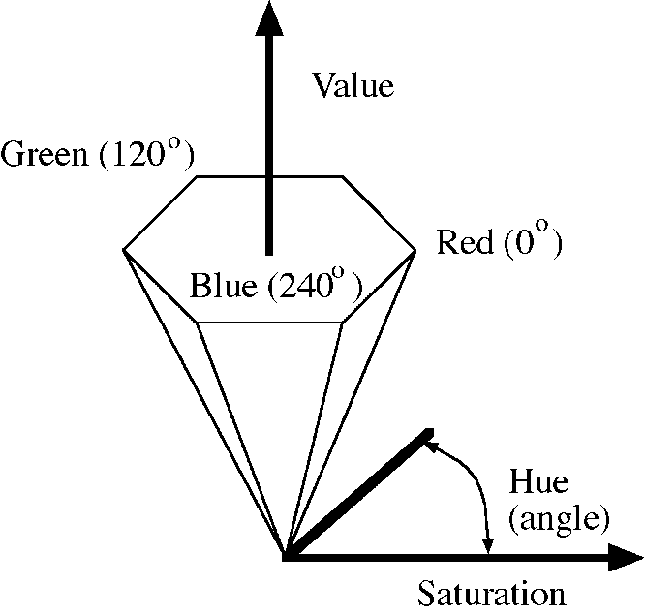
Nonlinear color spaces: HSV
Perceptually meaningful dimensions: Hue, Saturation, Value (Intensity)
RGB cube on its vertex

Slide 44
Overview of Color
Physics of color
Human encoding of color
Color spaces
White balancing

Slide 45
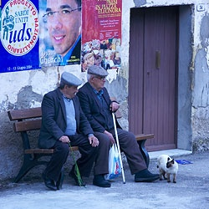
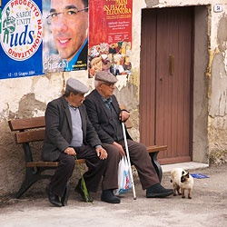
White balance
When looking at a picture on screen or print, we adapt to the illuminant of the room, not to that of the scene in the picture
When the white balance is not correct, the picture will have an unnatural color “cast”
incorrect white balance
correct white balance
http://www.cambridgeincolour.com/tutorials/white-balance.htm
Notes:
White balance (WB) is the process of removing unrealistic color casts, so that objects which appear white in person are rendered white in your photo.

Slide 46
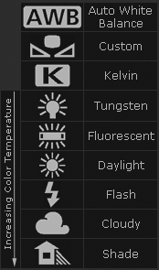
White balance
Film cameras:
Different types of film or different filters for different illumination conditions
Digital cameras:
Automatic white balance
White balance settings corresponding to several common illuminants
Custom white balance using a reference object
http://www.cambridgeincolour.com/tutorials/white-balance.htm
Slide: F. Durand

Slide 47
White balance
Von Kries adaptation
Multiply each channel by a gain factor
A more general transformation would correspond to an arbitrary 3x3 matrix
Slide: F. Durand
Notes:
The von Kries coefficient law in color adaptation describes the relationship between the illuminant and the human visual system sensitivity.

Slide 48
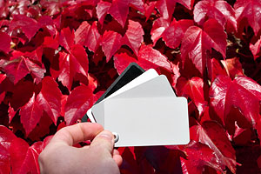
White balance
Von Kries adaptation
Multiply each channel by a gain factor
A more general transformation would correspond to an arbitrary 3x3 matrix
Best way: gray card
Take a picture of a neutral object (white or gray)
Deduce the weight of each channel
If the object is recoded as r_{w}, g_{w}, b_{w} use weights 1/r_{w}, 1/g_{w}, 1/b_{w}
Slide: F. Durand

Slide 49
White balance
Without gray cards: we need to “guess” which pixels correspond to white objects
Gray world assumption
The image average r_{ave}, g_{ave}, b_{ave} is gray
Use weights 1/r_{ave}, 1/g_{ave}, 1/b_{ave}
Brightest pixel assumption (non-staurated)
Highlights usually have the color of the light source
Use weights inversely proportional to the values of the brightest pixels
Gamut mapping
Gamut: convex hull of all pixel colors in an image
Find the transformation that matches the gamut of the image to the gamut of a “typical” image under white light
Use image statistics, learning techniques
Slide: F. Durand

Slide 50
Uses of color in computer vision
Color histograms for indexing and retrieval
Swain and Ballard, Color Indexing, IJCV 1991.

Slide 51
Uses of color in computer vision
Skin detection
M. Jones and J. Rehg, Statistical Color Models with Application to Skin Detection, IJCV 2002.
Source: S. Lazebnik

Slide 52
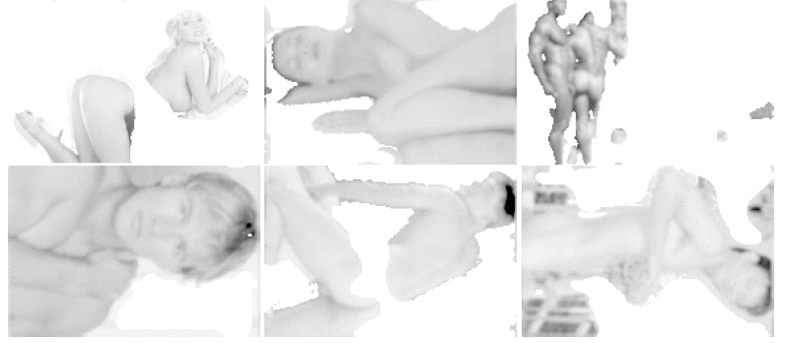
Uses of color in computer vision
Nude people detection
Forsyth, D.A. and Fleck, M. M., ``Automatic Detection of Human Nudes,'' International Journal of Computer Vision , 32 , 1, 63-77, August, 1999

Slide 53
Uses of color in computer vision
Image segmentation and retrieval
C. Carson, S. Belongie, H. Greenspan, and Ji. Malik, Blobworld: Image segmentation using Expectation-Maximization and its application to image querying, ICVIS 1999.
Source: S. Lazebnik

Slide 54
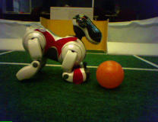
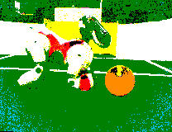
Uses of color in computer vision
Robot soccer
M. Sridharan and P. Stone, Towards Eliminating Manual Color Calibration at RoboCup. RoboCup-2005: Robot Soccer World Cup IX, Springer Verlag, 2006
Source: K. Grauman

Slide 55
Uses of color in computer vision
Building appearance models for tracking
D. Ramanan, D. Forsyth, and A. Zisserman. Tracking People by Learning their Appearance. PAMI 2007.
Source: S. Lazebnik

